Slide 1
ASP.NET Core & ReactJS
Toni Petrina
@to_pe
Synergy Sports Technology, GigPin, Microsoft MVP

Slide 2
Agenda
SPA introduction
ASP.NET Core, React, Typescript
Conclusion

Slide 3
Time before SPA
http://host/path
  Handle URL (routing)
  Go to database
  Generate HTML/CSS/JS and send to client
Follow URL http://host/path/action
  Handle URL (routing)
  Go to database
  Generate HTML/CSS/JS and send to client
…

Slide 4
2004 first SPA – GMail & AJAX
How to generate HTML?
How to handle styles?
No module system for frontend
CSS has similar issues – scoping, vars, etc…

Slide 5
Time before SPA
http://host/path
  Fetch entire client side app
Go to http://host/api/path
  Generate HTML/CSS/JS and send to client send JSON/XML/ProtoBuff
  Render result on client
Follow URL http://host/path/action in client only! go to API endpoint
  Generate HTML/CSS/JS and send to client send JSON/XML/ProtoBuff
…

Slide 6
Problems in modern web development
Templating and DOM manipulation
UI & logic decoupling (architectural patterns)
Code organization (no modules in JS)
Styles organization and preview

Slide 7
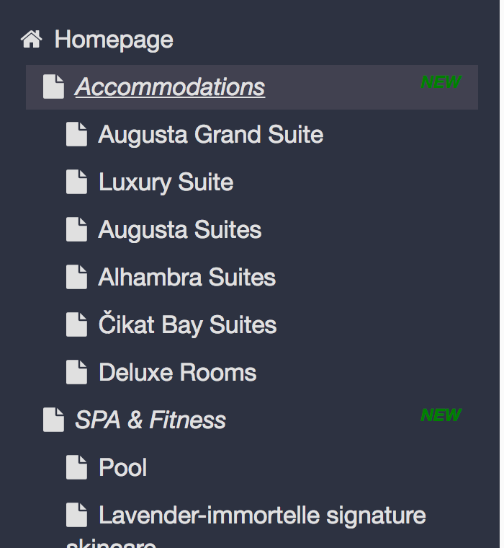
Templating…jQuery style
var root = $('#page-list-view-container');
root.empty();
app.pages.map(function (page) {
$("<a>")
.attr('href', "#")
.addClass(page.isDraft ? 'draft-page-litem' : 'published-page-litem')
.addClass('page-level-' + page.level)
.addClass(page.isDraft ? (page.isNew ? 'page-new' : 'page-draft') : 'page-published')
.attr('data-pageId', page.id)
.append($('<li>')
.text(page.name)
.prepend($('<span>')
.addClass('fa')
.addClass(page.level == 0 ? 'fa-home' : 'fa-file')
)
)
.appendTo(root);
})
addClickHandlerToSelectPages();

Slide 8
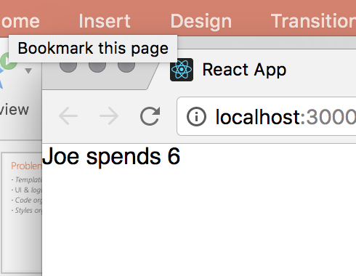
Mustache templating
var view = {
title: "Joe",
calc: function () {
return 2 + 4;
}
};
var output = Mustache.render("{{title}} spends {{calc}}", view);

Slide 9
DOM manipulation
// add class selected on click
$("#page-list-view-container [data-pageid=" + selectedPageId + "]")
.find("li")
.addClass('selected')
Finding element with magic strings and concatenation
Manual update?

Slide 10
Event handling?
var addClickHandlerToSelectPages = function () {
draftPageItem = document.getElementsByClassName('draft-page-litem'),
publishedPageItem = document.getElementsByClassName('published-page-litem');
$(draftPageItem).add($(publishedPageItem)).on('click', function (e) {
e.preventDefault();
selectedPageId = this.getAttribute('data-pageid');
history.pushState({ selectedPage: selectedPageId }, 'page ' + selectedPageId, '?selectedPage=' + selectedPageId)
selectPage(selectedPageId)
});
}

Slide 11
UI updates?
var addClickHandlerToSelectPages = function () {
draftPageItem = document.getElementsByClassName('draft-page-litem'),
publishedPageItem = document.getElementsByClassName('published-page-litem');
$(draftPageItem).add($(publishedPageItem)).on('click', function (e) {
e.preventDefault();
selectedPageId = this.getAttribute('data-pageid');
history.pushState({ selectedPage: selectedPageId }, 'page ' + selectedPageId, '?selectedPage=' + selectedPageId)
selectPage(selectedPageId)
});
}

Slide 12
ReactJS

Slide 13
What is ReactJS?
A JAVASCRIPT LIBRARY FOR BUILDING USER INTERFACES
SPA Framework
Declarative
Functional
Component oriented
"Just a view layer"

Slide 14
Klasa: React.Component
Metode:
render
setState
componentWillMount
componentWillReceiveProps
componentDidMount
componentWillUnmount
shouldComponentUpdate
componentDidUpdate
componentWillUpdate
Properties:
state, props, children
JSX + virtual DOM + synthetic events
<div>
<span>{this.props.text}</span>
<button onClick={this.props.handleClick}>
Click me</button>
</div>

Slide 15
React component
Importing external modules (NPM ili lokalno)
import * as React from 'react';
export default class Header extends React.Component<any, any> {
render() {
return <h1>Title goes here</h2>
}
}
Export for other modules to see
JSX

Slide 16
HTML inside JavaScripta ECMAScript?

Slide 17
DEMO

Slide 18
f(state, props) = view
React in a nutshell

Slide 19
SPA means SPA
Single page – 1 or one view index.html
Routing is client-side
Server side routing can be used for heavy lifting
Server side rendering is an option

Slide 20
Glossary
.NET Core – platform
ASP.NET Core – framework
ReactJS – SPA library
JavaScriptServices – handles SPA inside ASP.NET Core/replaces Razor
Tools: npm, webpack, nuget, dotnet CLI
Concepts: Single Page App, client-side routing

Slide 21
JavaScriptServices
node.js se running under ASP.NET Core
webpack used for bundling
Hot Module Reload (HMR)
Typescript – optional types for JavaScript
https://github.com/aspnet/javascriptservices

Slide 22
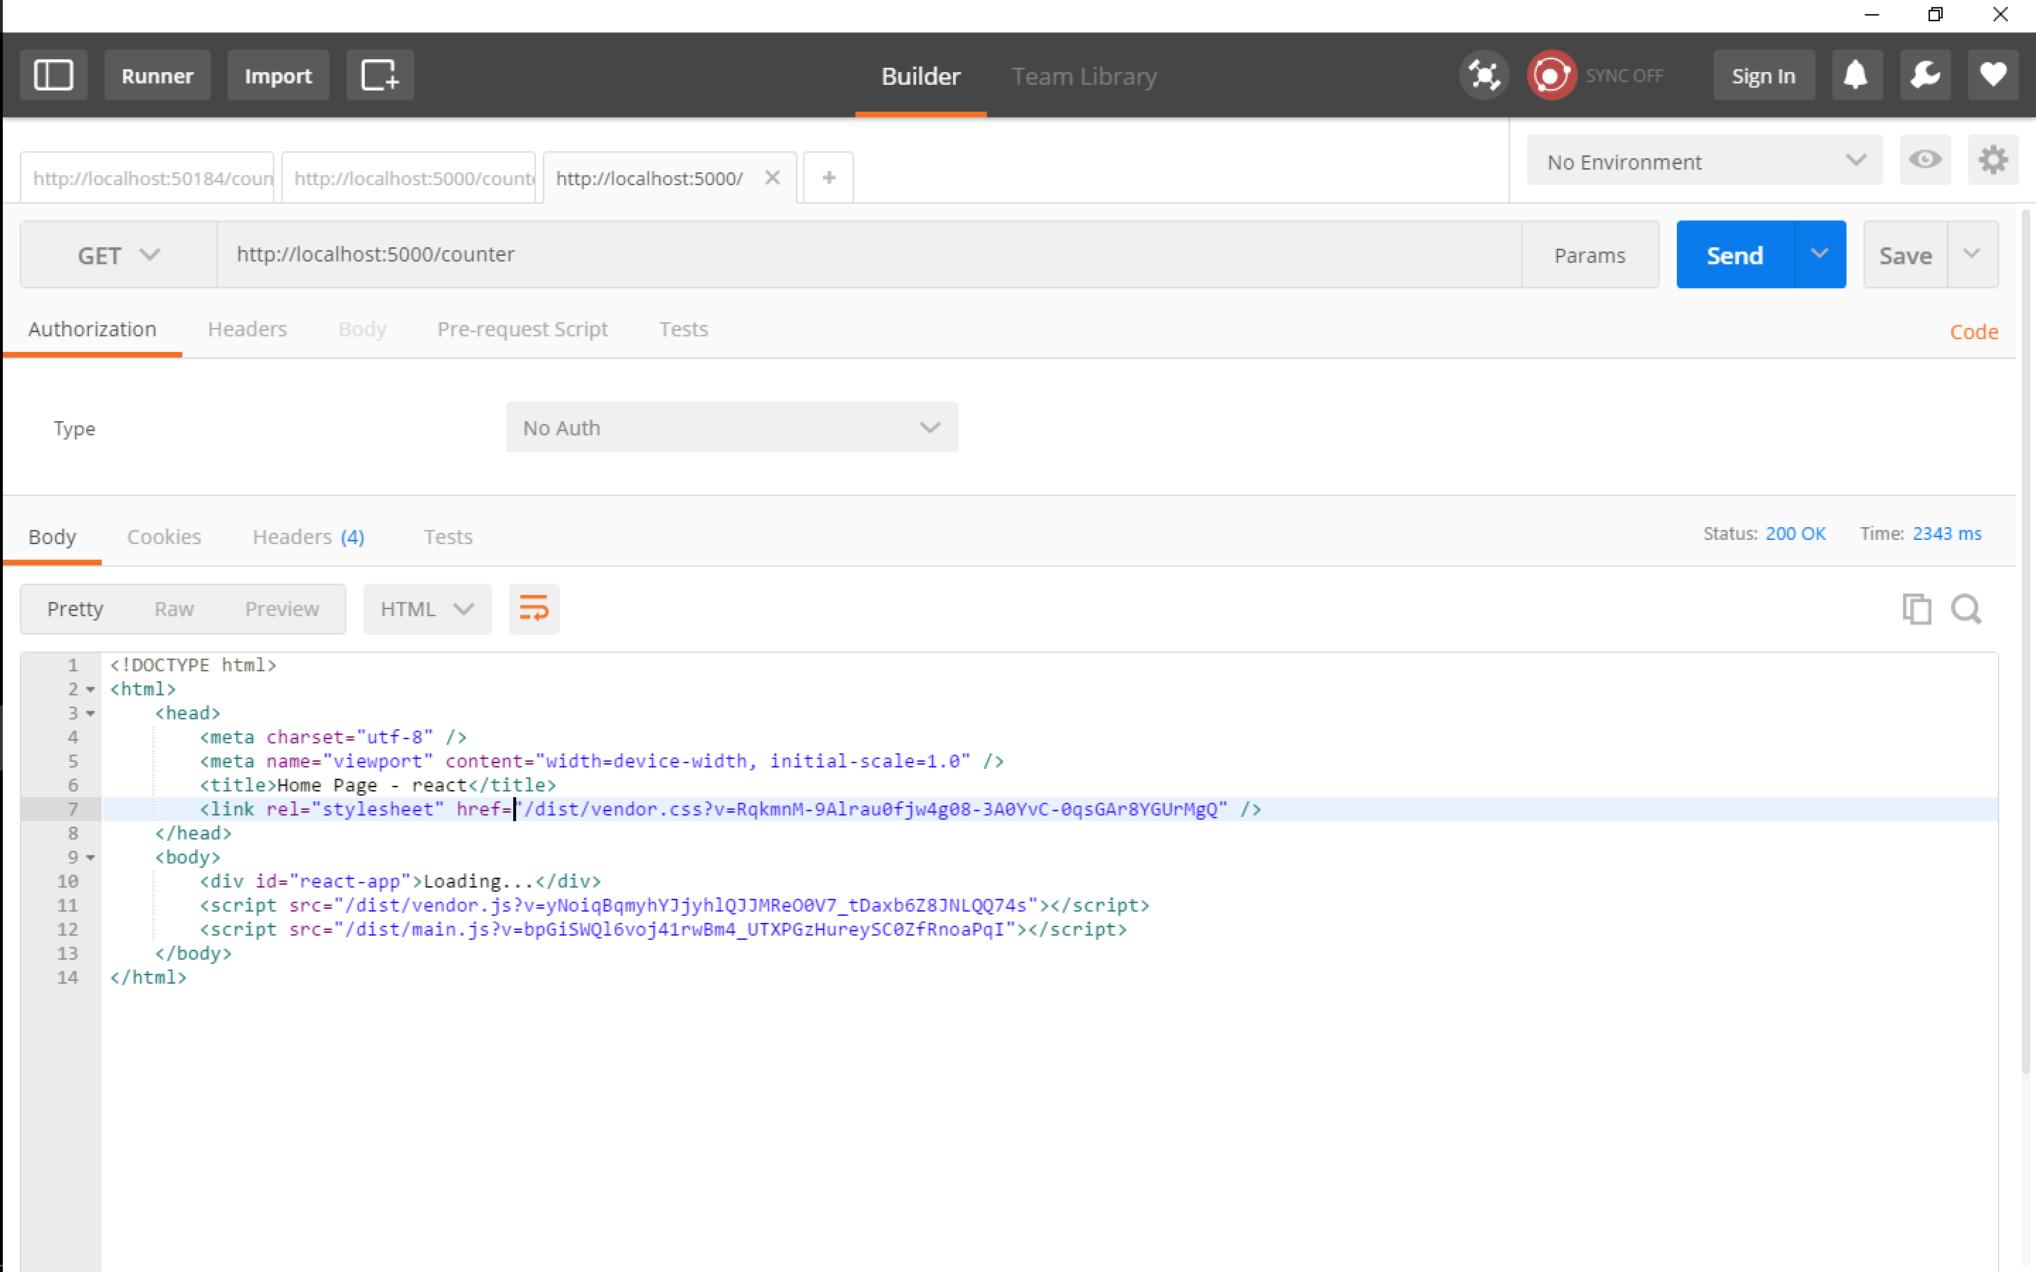
Client side

Slide 23
Good start
dotnet new react
npm install
dotnet run
$env:ASPNETCORE_ENVIRONMENT="Development"

Slide 24
Dotnet watch
<DotNetCliToolReference Include="Microsoft.DotNet.Watcher.Tools" Version="2.0.0" />
dotnet watch run

Slide 25
API Controller
[Route("api/[Controller]")]
public class ListController : Controller
{
public IActionResult Get()
{
return Ok(new[]
{
new {id=1, name="john"}
});
}
}

Slide 26
componentDidMount() {
fetch("/api/list")
.then(r => r.json() as Promise<Item[]>)
.then(items => this.setState({ items: items }))
}

Slide 27
async componentDidMount() {
let response = await fetch("/api/list")
let data = await response.json()
this.setState({ items: data })
}

Slide 28
Swashbuckle
dotnet add package Swashbuckle.AspNetCore

Slide 29
Routing! react-router
export default <Route component={Layout}>
<Route path='/' components={{ body: Home }} />
<Route path='/counter' components={{ body: Counter }} />
<Route path='/fetchdata' components={{ body: FetchData }}>
<Route path='(:startDateIndex)' /> {
/* Optional route segment that does not affect NavMenu highlighting */
}
</Route>
<Route path='/sample' components={{ body: Sample }} />
<Route path='/sampleredux' components={{ body: SampleRedux }} />
</Route>;

Slide 30
app.UseMvc(routes =>
{
routes.MapRoute(
name: "default",
template: "{controller=Home}/{action=Index}/{id?}");
});
// here you can see we make sure it doesn't start with /api, if it does, it'll 404 within .NET if it can't be found
app.MapWhen(x => !x.Request.Path.Value.StartsWith("/api"), builder =>
{
builder.UseMvc(routes =>
{
routes.MapSpaFallbackRoute(
name: "spa-fallback",
defaults: new { controller = "Home", action = "Index" });
});
});

Slide 31
EntityFrameworkCore
dotnet add package Microsoft.EntityFrameworkCore.SqlServer

Slide 32
What next?
Code splitting & Tree shaking
Using external libraries
Advanced routing
Advanced state management
Server Side Rendering

Slide 33
https://tpetrina.gitbooks.io/react-aspnetcore-training/content/
Toni Petrina
Massive Pixel d.o.o.
@to_pe
toni@massivepixel.co

